Slide 1


An Analysis of the Android App Market
By Balaji Chandrasekaran, Edward Kim, Kevin Kung, Aravind Krishnamoorthy, & Kevin Young

Slide 2

Agenda
Google Play Store - Current Trends
Business Value Proposition - Why This Project?
Dataset Description
Data Wrangling
Exploratory Data Analysis
Model Building
Business Insights and Recommendations

Slide 3
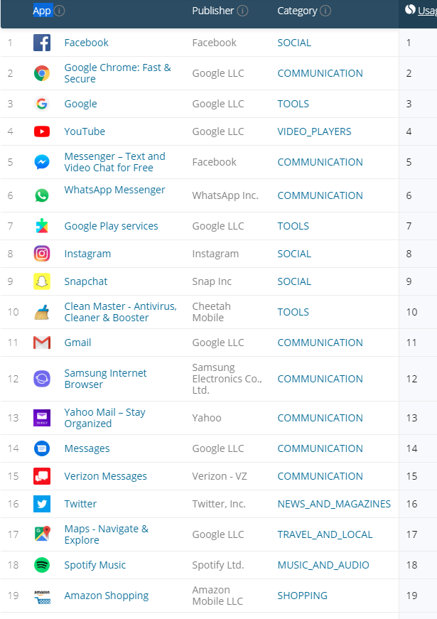
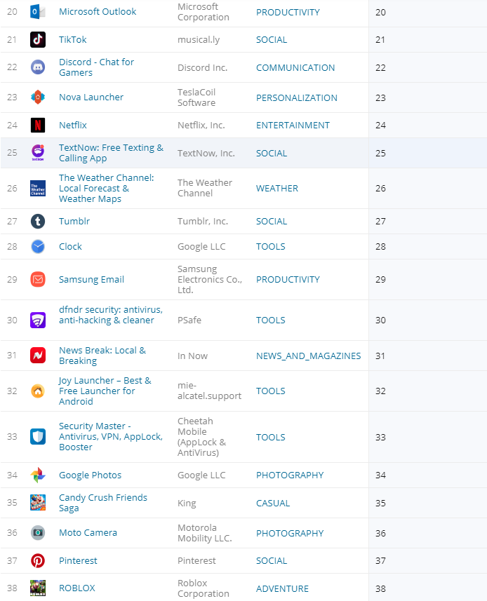
Google Play Store Current Trends

Slide 4
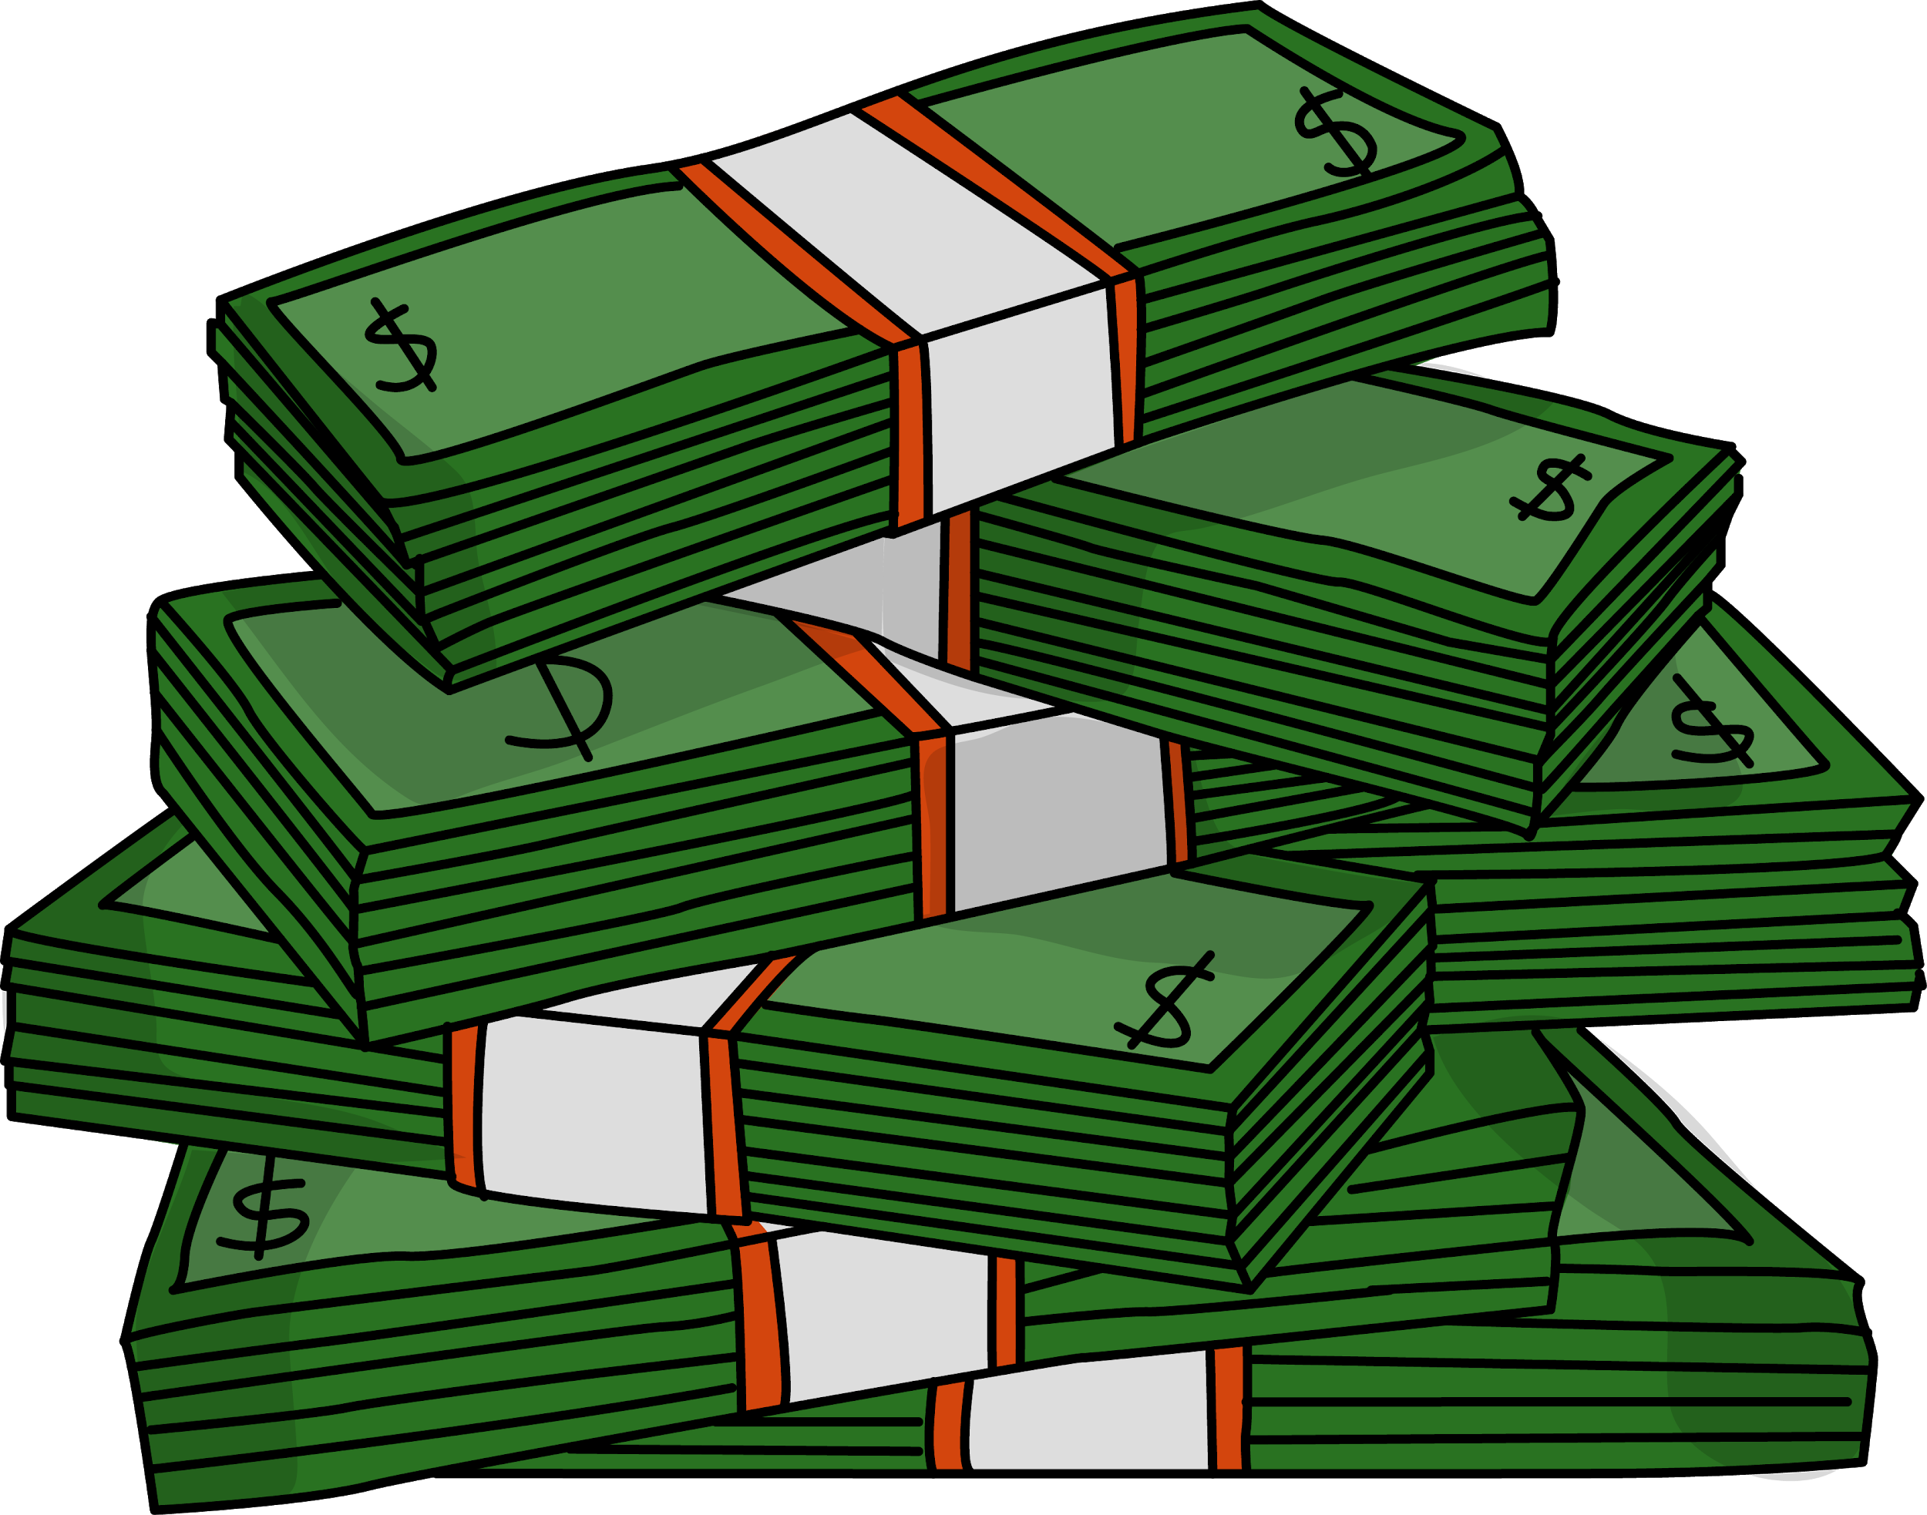
Business Value Proposition
The Mobile App ecosystem is large and continues to grow. In 2016, revenue reached $88 billion, and by 2020 forecasted mobile app revenue will reach $189 billion
Google App Marketplace is an open source environment with more apps, compared to Apple’s.
Identify the types of apps currently in the app store, specific apps that are selling, purchasing trends of consumers, popular categories, and features customers like or dislike
This model allows one to price your apps with either paid on features or free based on past data

Slide 5

Dataset Description
Dataset 1:
Number of records: 10482
App Name
Category
Rating
Reviews (Number of Reviews)
Size
Installs
Type (Free or Paid)
Price
Content Rating (Everyone, Teen, or any specific target audience)
Genres
Last Updated
Current Version
Android Version
Dataset 2:
Number of records: 64296
App Name
Translated_Review
Sentiment (Postive, Nan, Neutral, Negative)
Sentiment_Polarity (Score of polarity)
Sentiment_Subjectivity (Subjective or Explanative review)
Dataset Source:
Data from 2010-2018

Slide 6

Data Wrangling
Dataset 1
Remove all duplicate entries (1181 duplicate records eliminated)
Handle NaN or Missing information
Rating 1463 15% , Type 1 , Current Ver 8, Android Ver 2
Rating NaN is replaced by Average of Category
Size field contained information with bytes, MegaBytes with ‘M” suffix, kiloBytes with ‘Kb’ sufffix. Cleaned up and transformed to MB scale. Also 'Varies with device‘ replaced by Category Mean
Price column transformed all units to dollars (numeric)
Installs and Reviews has very high dynamic range: few hundreds to billions. Transformed to log10 scale
Junk apps with very high prices ( > $100) are discarded
All cleaned up data are converted to .ARFF format for model building

Slide 7
Data Wrangling
Dataset 2
Handle NaN or Missing information
Merged with dataset1 using App name as primary key (“ SQL Inner Join”)
Every app contains number of positive/number of negative and number of neutral reviews, mean score and mean subjectivity score
Only 25% of the apps have user reviews (Dataset limitation)

Slide 8
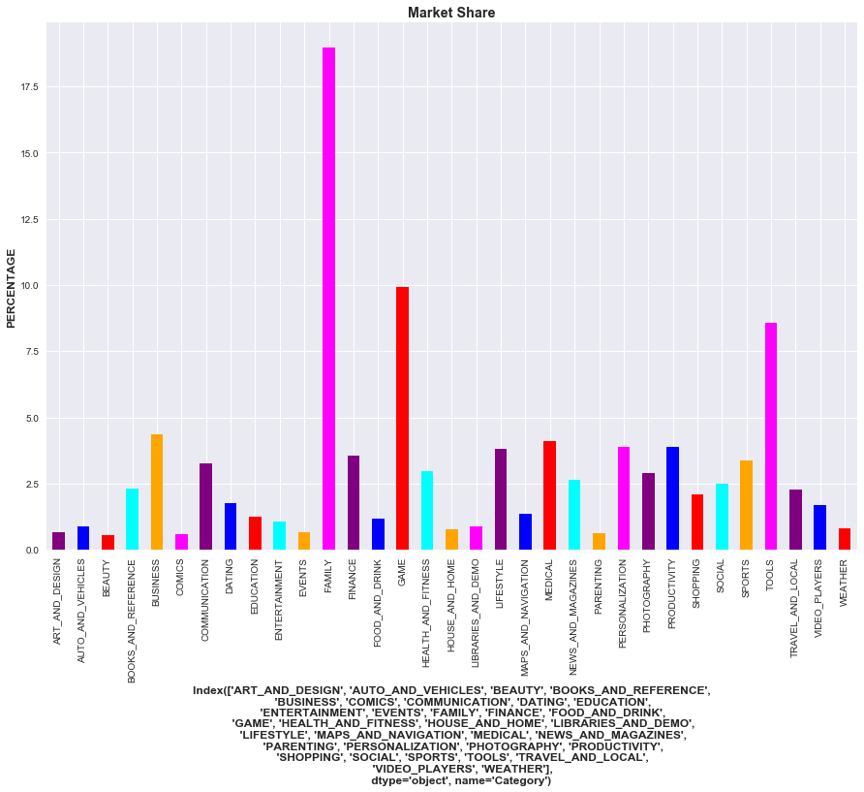
Exploratory Data Analysis
Market distribution:
Dataset 34 different categories
Family
Game
Tools
Business & Communication
50% Market share

Slide 9
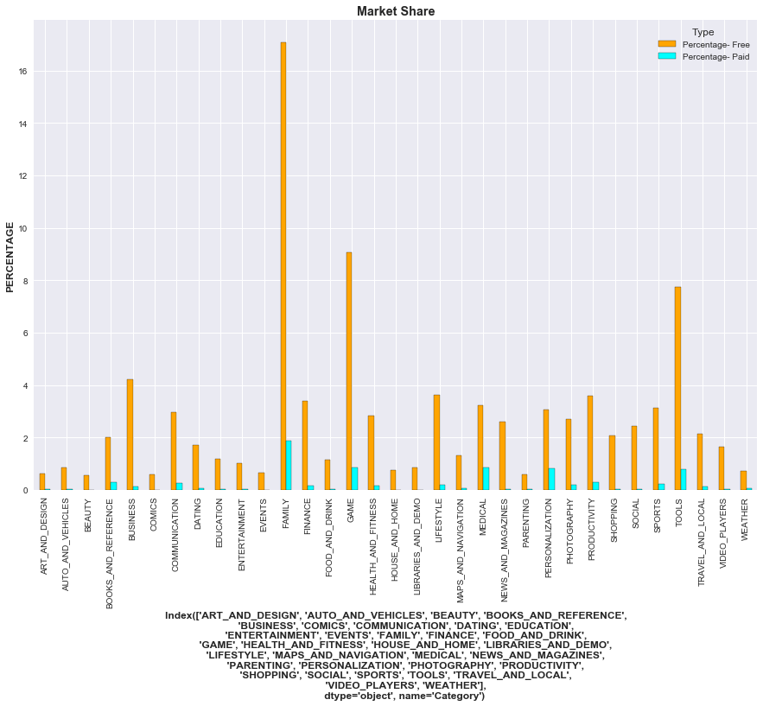
Market distribution:
Paid and Free Apps in each category

Slide 10
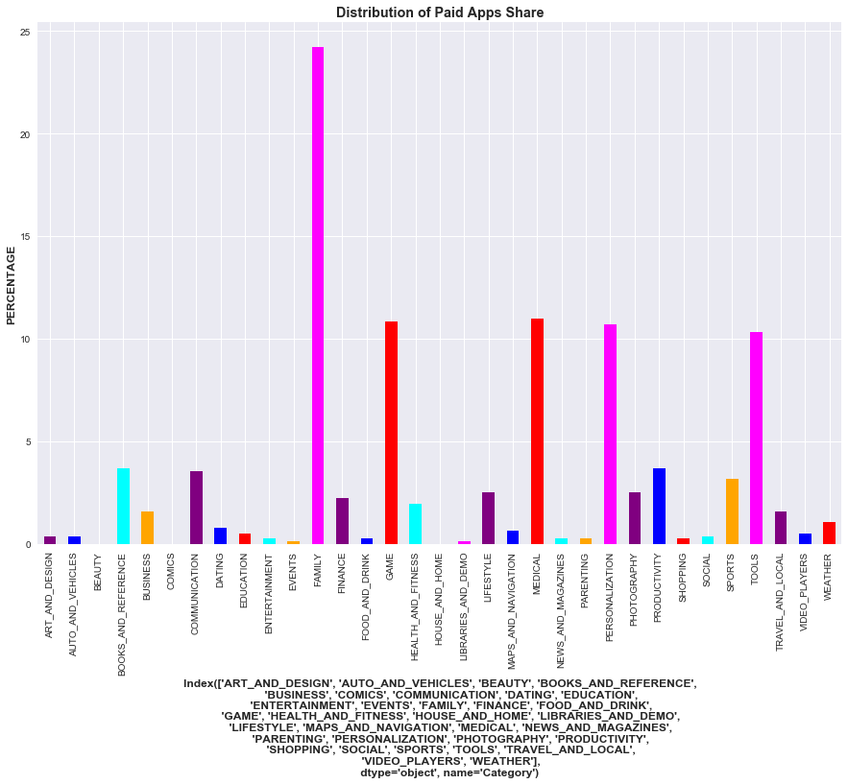
Paid only Apps distribution:
Major shareholders:
Family, Game, Medical, Personalization and Tools
Mean price of all paid-only apps is $22

Slide 11
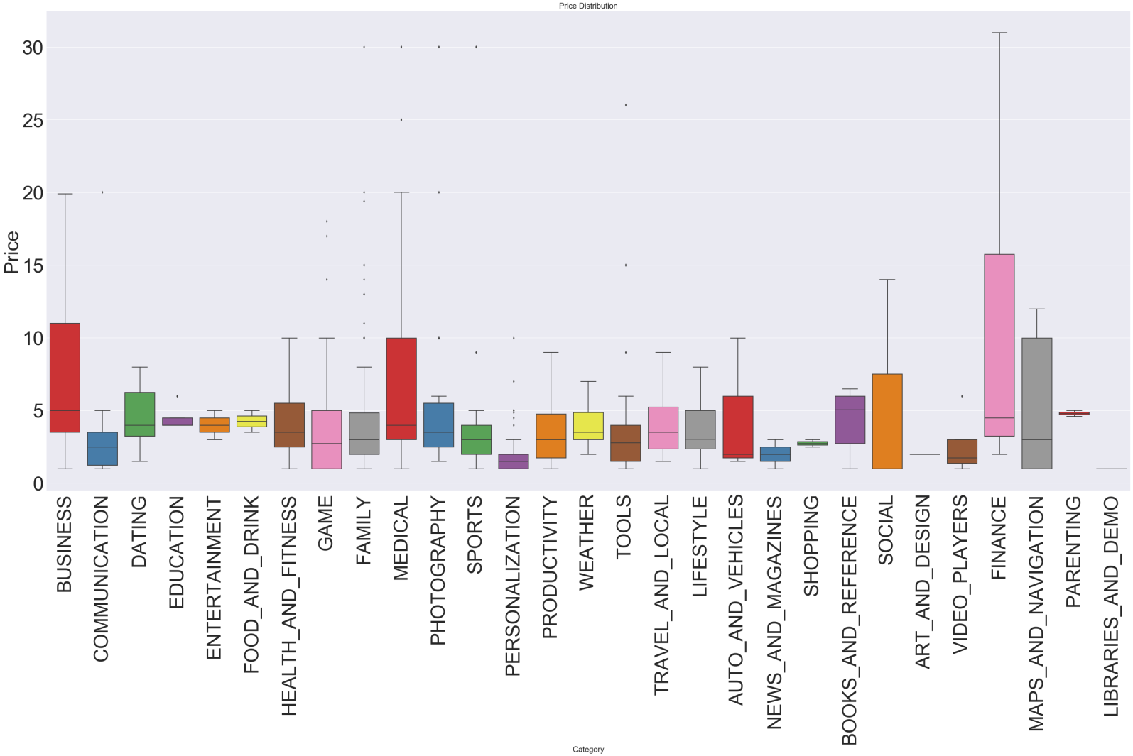
Price Distribution
Top 10 mean prices:
Category | Price
FINANCE | 10.59
MEDICAL | 8.00
BUSINESS | 7.75
PHOTOGRAPHY | 6.22
LIFESTYLE | 6.22
MAPS_AND_NAVIGATION | 5.39
SOCIAL | 5.32
PARENTING | 4.79
DATING | 4.57
FAMILY | 4.52

Slide 12
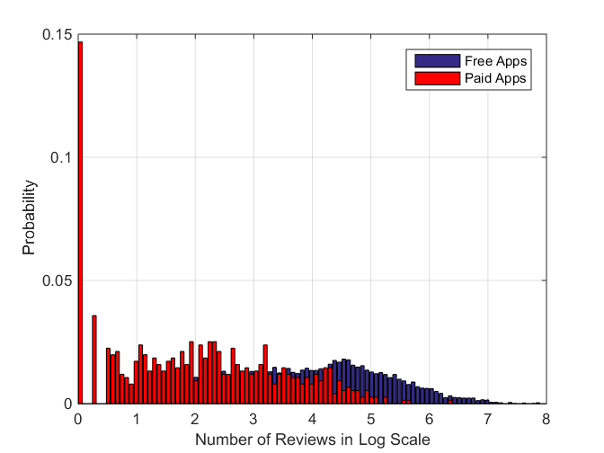
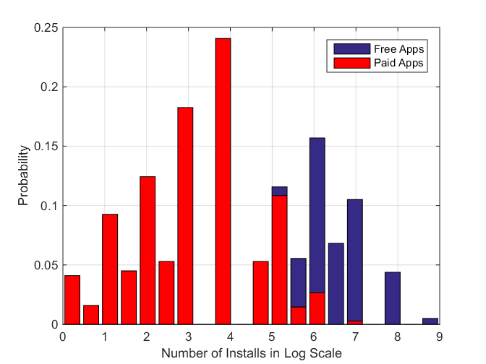
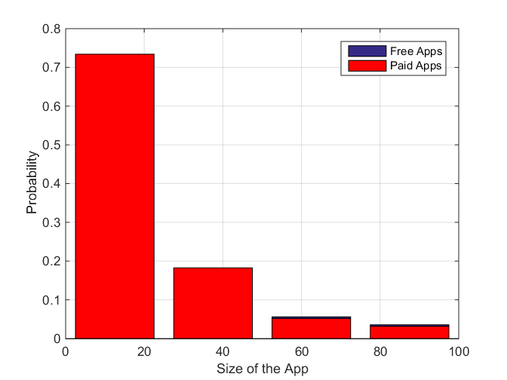
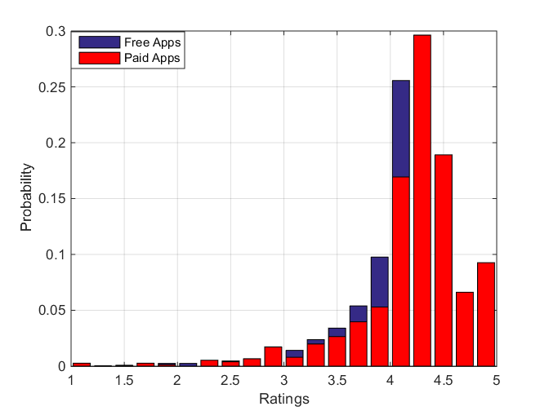
Frequency Distribution
Mean Free = 234270
Mean Paid = 8800
Mean Free Apps = 8432439
Mean Paid Apps = 75879
Mean Free = 20 MB
Mean Paid = 20 MB
Mean Free Apps = 4.165
Mean Paid Apps = 4.25

Slide 13
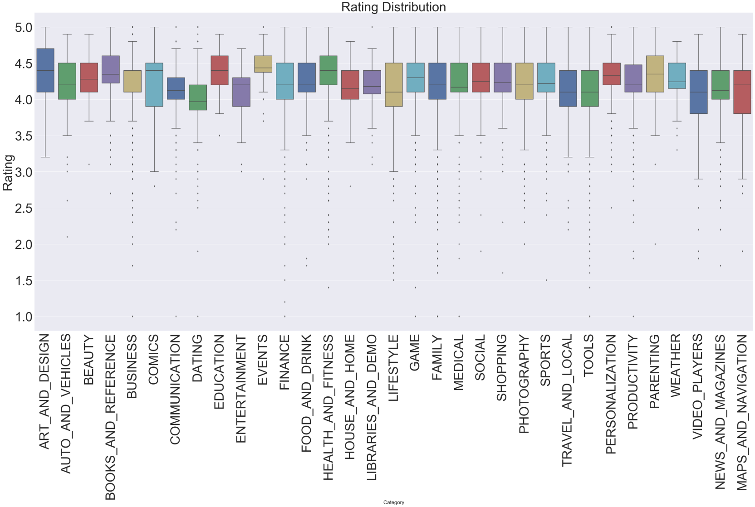
Rating Distribution
Overall mean rating is 4.125.
Education, Beauty, Event planning apps are rated above mean and overall good ratings

Slide 14
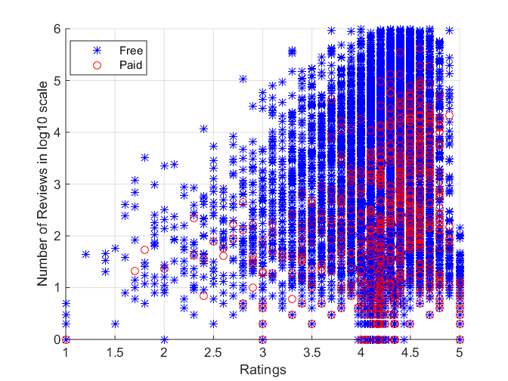
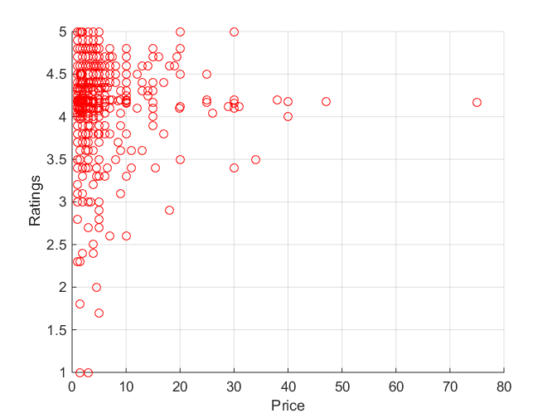
Relationship Between Attributes
Highly rated apps have high number of Reviews (Linear relationship)
Highly rated apps are price under $10

Slide 15
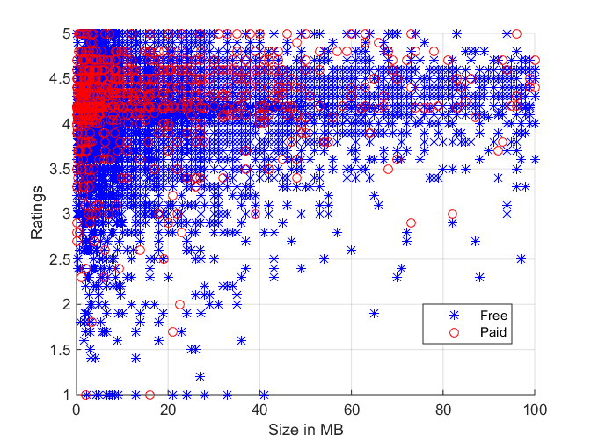
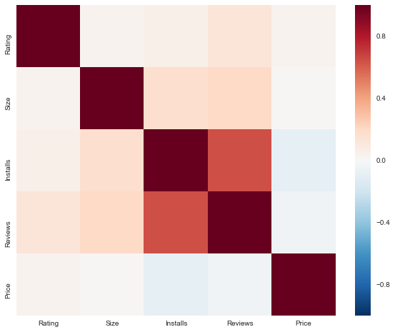
Relationship Between Attributes
Installs and Reviews are positively correlated
Installs/Reviews and Price are negatively correlated
Highly Rated Apps are
0.5-20 MB is an ideal App Size

Slide 16
Top Trending Apps Insights
App Name | Category | Rating | Reviews | Size MB | Installs | Pay Type
Facebook | SOCIAL | 4.1 | 78158306 | 15.98409 | 1000000000 | Free
WhatsApp Messenger | COMMUNICATION | 4.4 | 69119316 | 11.30743 | 1000000000 | Free
Instagram | SOCIAL | 4.5 | 66577313 | 15.98409 | 1000000000 | Free
Messenger – Text and Video Chat for Free | COMMUNICATION | 4 | 56642847 | 11.30743 | 1000000000 | Free
Clash of Clans | GAME | 4.6 | 44891723 | 98 | 100000000 | Free
Clean Master- Space Cleaner & Antivirus | TOOLS | 4.7 | 42916526 | 8.782837 | 500000000 | Free
Subway Surfers | GAME | 4.5 | 27722264 | 76 | 1000000000 | Free
YouTube | VIDEO_PLAYERS | 4.3 | 25655305 | 15.792756 | 1000000000 | Free
Security Master - Antivirus, VPN, AppLock, Boo... | TOOLS | 4.7 | 24900999 | 8.782837 | 500000000 | Free
Clash Royale | GAME | 4.6 | 23133508 | 97 | 100000000 | Free
Candy Crush Saga | GAME | 4.4 | 22426677 | 74 | 500000000 | Free
UC Browser - Fast Download Private & Secure | COMMUNICATION | 4.5 | 17712922 | 40 | 500000000 | Free
Snapchat | SOCIAL | 4 | 17014787 | 15.98409 | 500000000 | Free
360 Security - Free Antivirus, Booster, Cleaner | TOOLS | 4.6 | 16771865 | 8.782837 | 100000000 | Free
My Talking Tom | GAME | 4.5 | 14891223 | 41.866609 | 500000000 | Free
8 Ball Pool | GAME | 4.5 | 14198297 | 52 | 100000000 | Free
DU Battery Saver - Battery Charger & Battery Life | TOOLS | 4.5 | 13479633 | 14 | 100000000 | Free
BBM - Free Calls & Messages | COMMUNICATION | 4.3 | 12842860 | 11.30743 | 100000000 | Free
Cache Cleaner-DU Speed Booster (booster & clea... | TOOLS | 4.5 | 12759663 | 15 | 100000000 | Free
Twitter | NEWS_AND_MAGAZINES | 4.3 | 11667403 | 12.470189 | 500000000 | Free
Apps matching all good criterion
Higher Installs
Higher Reviews
Higher than 4.125 (Mean Rating)
Free/Lower Pay
Lower Size

Slide 17
User Sentiment Analysis
CATEGORIES | Negative % | Neutral % | Positive %
BOOKS_AND_REFERENCE | 8 | 10 | 81
BUSINESS | 10 | 20 | 69
COMMUNICATION | 23 | 18 | 57
DATING | 5 | 15 | 79
EDUCATION | 9 | 14 | 76
ENTERTAINMENT | 32 | 14 | 52
FAMILY | 47 | 2 | 50
FINANCE | 26 | 12 | 60
FOOD_AND_DRINK | 19 | 8 | 72
GAME | 39 | 3 | 56
HEALTH_AND_FITNESS | 10 | 10 | 80
LIBRARIES_AND_DEMO | 10 | 35 | 53
LIFESTYLE | 33 | 41 | 25
MAPS_AND_NAVIGATION | 26 | 20 | 52
MEDICAL | 21 | 26 | 51
NEWS_AND_MAGAZINES | 39 | 6 | 54
Strong Negative:
Paid apps with ads strong negative
Bugs or crashes
Strong Positive
Specialized apps
Faster and user friendly

Slide 18
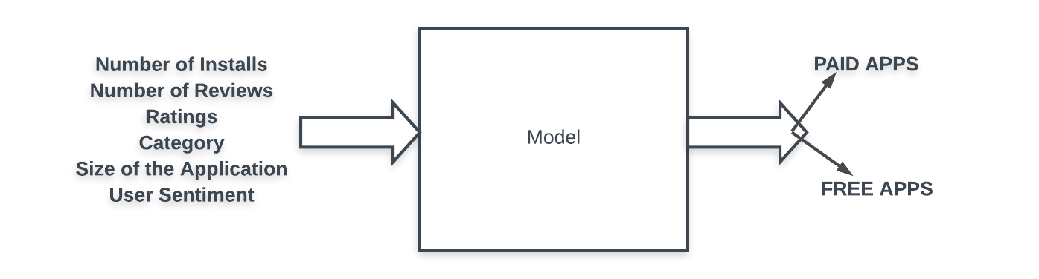

Model Building
Confusion Matrix | Label Paid Apps (1) | Label Free Apps (0)
Predicted Paid Apps (1) | True Positive | False Positive
Predicted Free apps (0) | False Negative | True Negative
Performance Metric:
Imbalanced data
Type[“Paid Apps = 1”] = 734 (7%)
Type[“Free Apps = 0”] = 8904 (93%)
Accuracy not chosen as metric
Precision = tp/(tp + fp)
Recall = tp/(tp+fn)

Slide 19
Model Building: First Iteration
Training: 7708; Testing = 1927
(80% & 20% random split)
Algorithm | Accuracy | Precision | Recall
Naive Bayesian | 87.25% | 94.74% | 9.7%
Logistic Regression | 91.09% | 25% | 2.44%
Decison Trees (J48) | 92.49% | 54.54% | 19.23%
Identify potential flaws ?
Data imbalance problem
Binning continuous variables
Confusion Matrix | Label Paid Apps (1) | Label Free Apps (0)
Predicted Paid Apps (1) | 30 (TP) | 25 (FP)
Predicted Free apps (0) | 126 (FN) | 1746 (TN)

Slide 20
Model Building: Second Iteration
Oversample WEKA filter (resampling filter)
Downsample “Free” Category and take all “Paid apps category
Oversample “Paid” app only on training set (SMOTE filter)
Resampled to eliminate class bias
Paid = 4829 (50%)
Free = 4829 (50%)
Algorithm | Accuracy | Precision | Recall
Naive Bayesian | 70.49% | 70.89% | 71.81%
Logistic Regression | 77.54% | 77.23% | 79.12%
Decison Trees (J48) | 93.79% | 90.43% | 96.16%
Significant improvement in performance.
But this is over fitting for the data. Also this mode of oversampling does not represent the real world performance (synthetic data overlaps from training and testing)

Slide 21
Model Building: Second Iteration
Downsample “Free” Category and take all “Paid apps category
Free ---> 8902 ---->(3) ----> 2968
Paid ---->734
Paid = 734 (20%)
Free = 2968 (80%) Training
Training and Testing split on 80% and 20% of this 3702 instances
Algorithm | Accuracy | Precision | Recall
Naive Bayesian | 83.24 | 65 | 27.46
Logistic Regression | 82.97 | 62.5 | 28.17
Decison Trees (J48) | 83.37 | 59.79 | 40.84
Performance improvement without overfitting

Slide 22
Model Building: Second Iteration
Downsample “Free” Category and take all “Paid apps category
Free ---> 8904 ---->(downsample 2)
Paid ---->734
Training (80%) - -> 4188
Testing ( 20 %) → 1048
Training (80%) - -> 4188
[3603 Free, 585 Paid]
Resample with “SMOTE” filter:
[3603 Free, 3603 Paid]
Testing: [899 “Free” (85%), 149 “Paid”(15%)]
Algorithm | Accuracy | Precision | Recall
Naive Bayesian | 77.27 | 68 | 24.46
Logistic Regression | 74.68 | 65 | 23
Decison Trees (J48) | 86 | 50.5 | 57.04
Performance improvement without overfitting

Slide 23
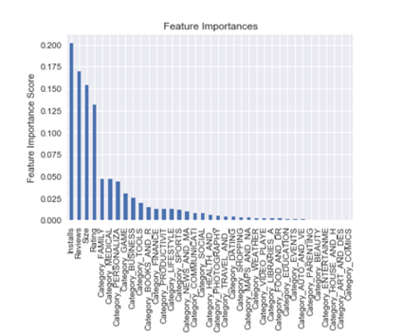
Model Building: Third Iteration
Categories section:
Family, Medical, Personalization, Game and Business and ALL Others
Binned: 34 categories to 6 categories
Reviews/Installs bins | Range
Low | 0 -1000
Average | 1000-100000
High | 100000 – 1 million
Mature Apps | >1million
Ratings | Range
Poor | 0 to 2.5
Average | 2.5 to 3.5
High | 3.5 to 4.5
Excellent | >4.5
Size bins | Range
Light Weight | 0-20 Mb
Mid Weight | 20-40 Mb
Heavy | 40-80 Mb
Bulky | >80 Mb

Slide 24
Model Building: Third Iteration
Algorithm | Algorithm Modifications | Accuracy | Precision | Recall
Naïve Bayesian | Binned Categories attribute | 57.82 | 20.76 | 69.80
Decision Trees (J48) | Binned Categories and Size attributes | 85.87 | 50.0 | 55.70
Naïve Bayesian | Binned Categories and Size attributes | 66.79 | 21.97 | 52.35
Decision Trees (J48) | Binned Categories Size and Rating attributes | 82.26 | 49.06 | 42.72
Naïve Bayesian | Binned Categories Size and Rating attributes | 50.28 | 19 | 76.51
Decision Trees (J48 | Binned Categories Rating, Installs and Review attributes | 75.68 | 29 | 52
Naïve Bayesian | Binned Categories Rating, Installs and Review attributes | 55.28 | 24.67 | 74.22
Decision Trees (J48) | Binned Categories attribute Install & Size | 88.26 | 62.68 | 57.53

Slide 25


Model Building: Final Chosen Model
Confusion Matrix | Label Paid Apps (1) | Label Free Apps (0)
Predicted Paid Apps (1) | 84 (TP) | 62 (FP)
Predicted Free apps (0) | 50 (FN) | 758 (TN)
Model Performance:
Precision = 63%
Recall = 58%

Slide 26

Business Recommendations
Specialized apps (Medical, Finance, Business) have lower number of installs:
Target High reviews and Ratings (Excellent ratings > 4.5)
Can be priced high (up to $80)
Lighter. Faster and Bug free
Non-specialized common apps
Faster. Target higher downloads and above average ratings (4.125)
Model low price or Free with ad revenue
Target sized apps (< 40 MB) except for gaming apps
Prevent ads or paid on features in apps priced > $10

Slide 27

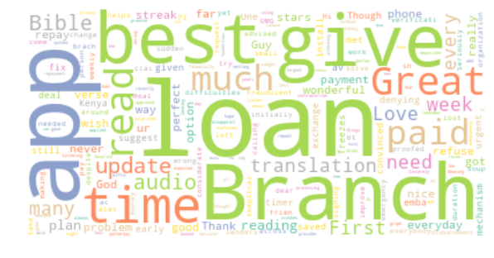
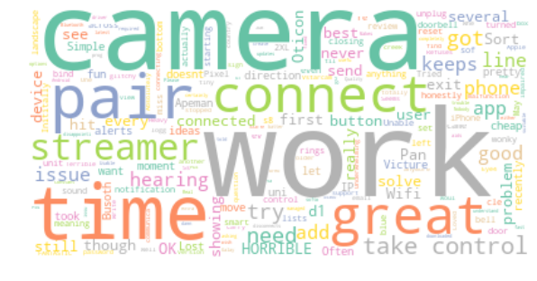
Questions ?
Word Cloud from Highly Rated Apps
Word Cloud from Poorly Rated Apps

